Slide 1


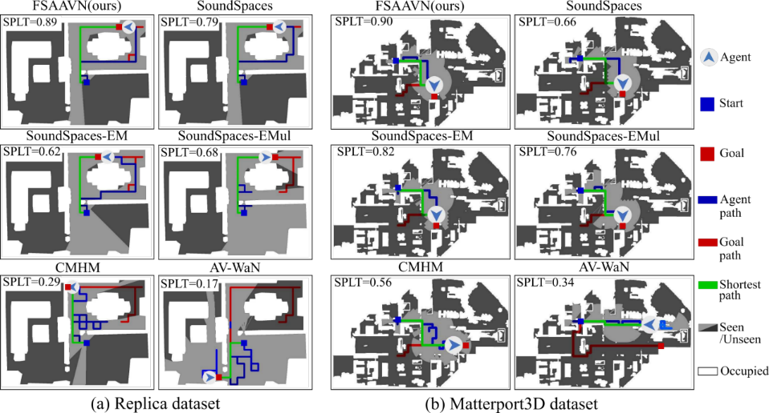
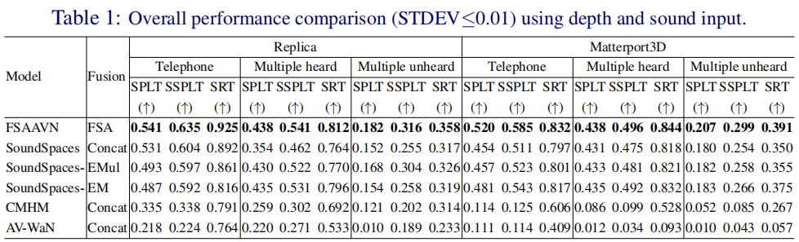
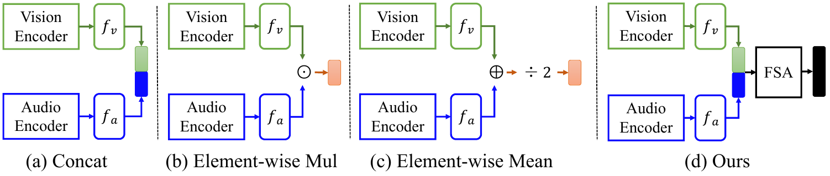
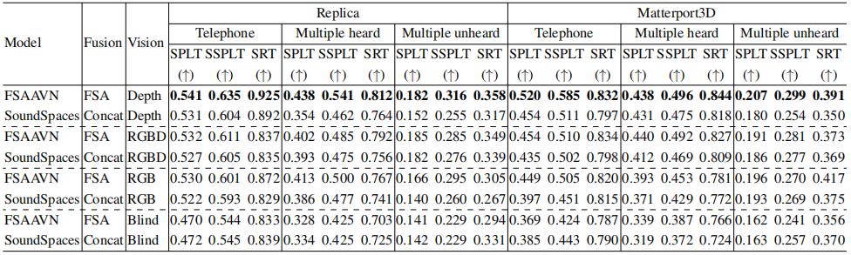
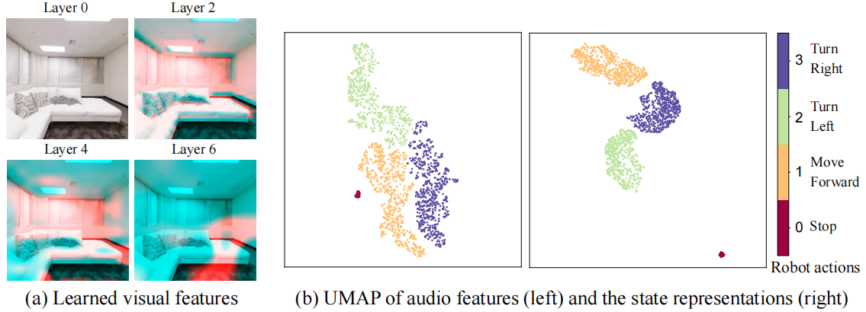
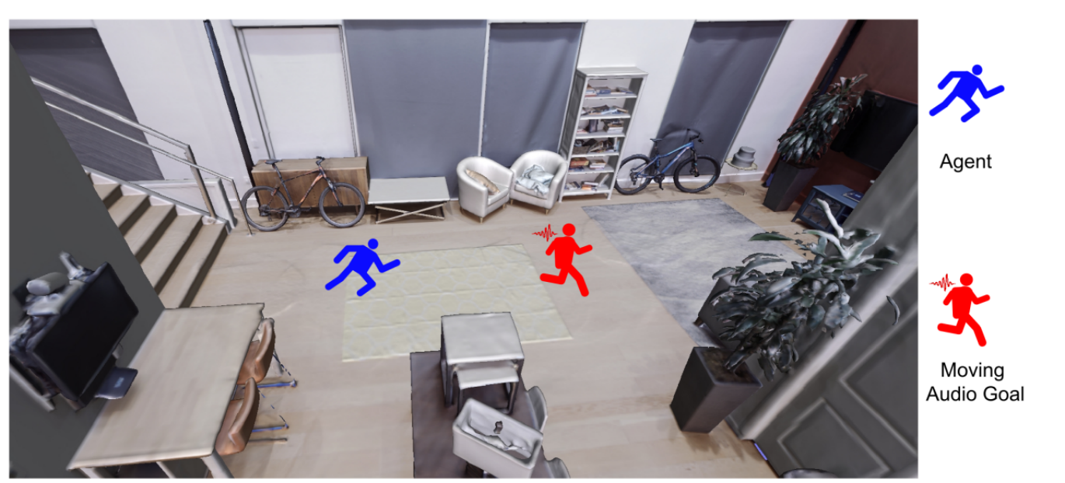
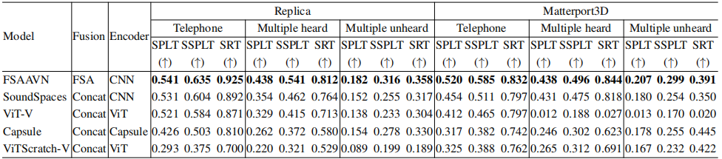
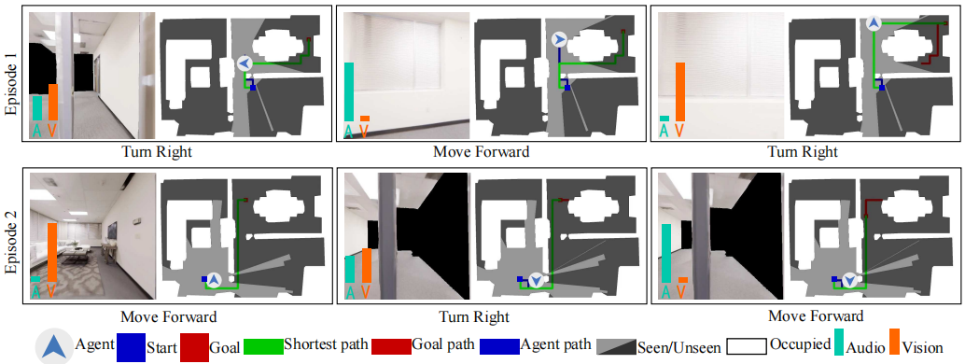
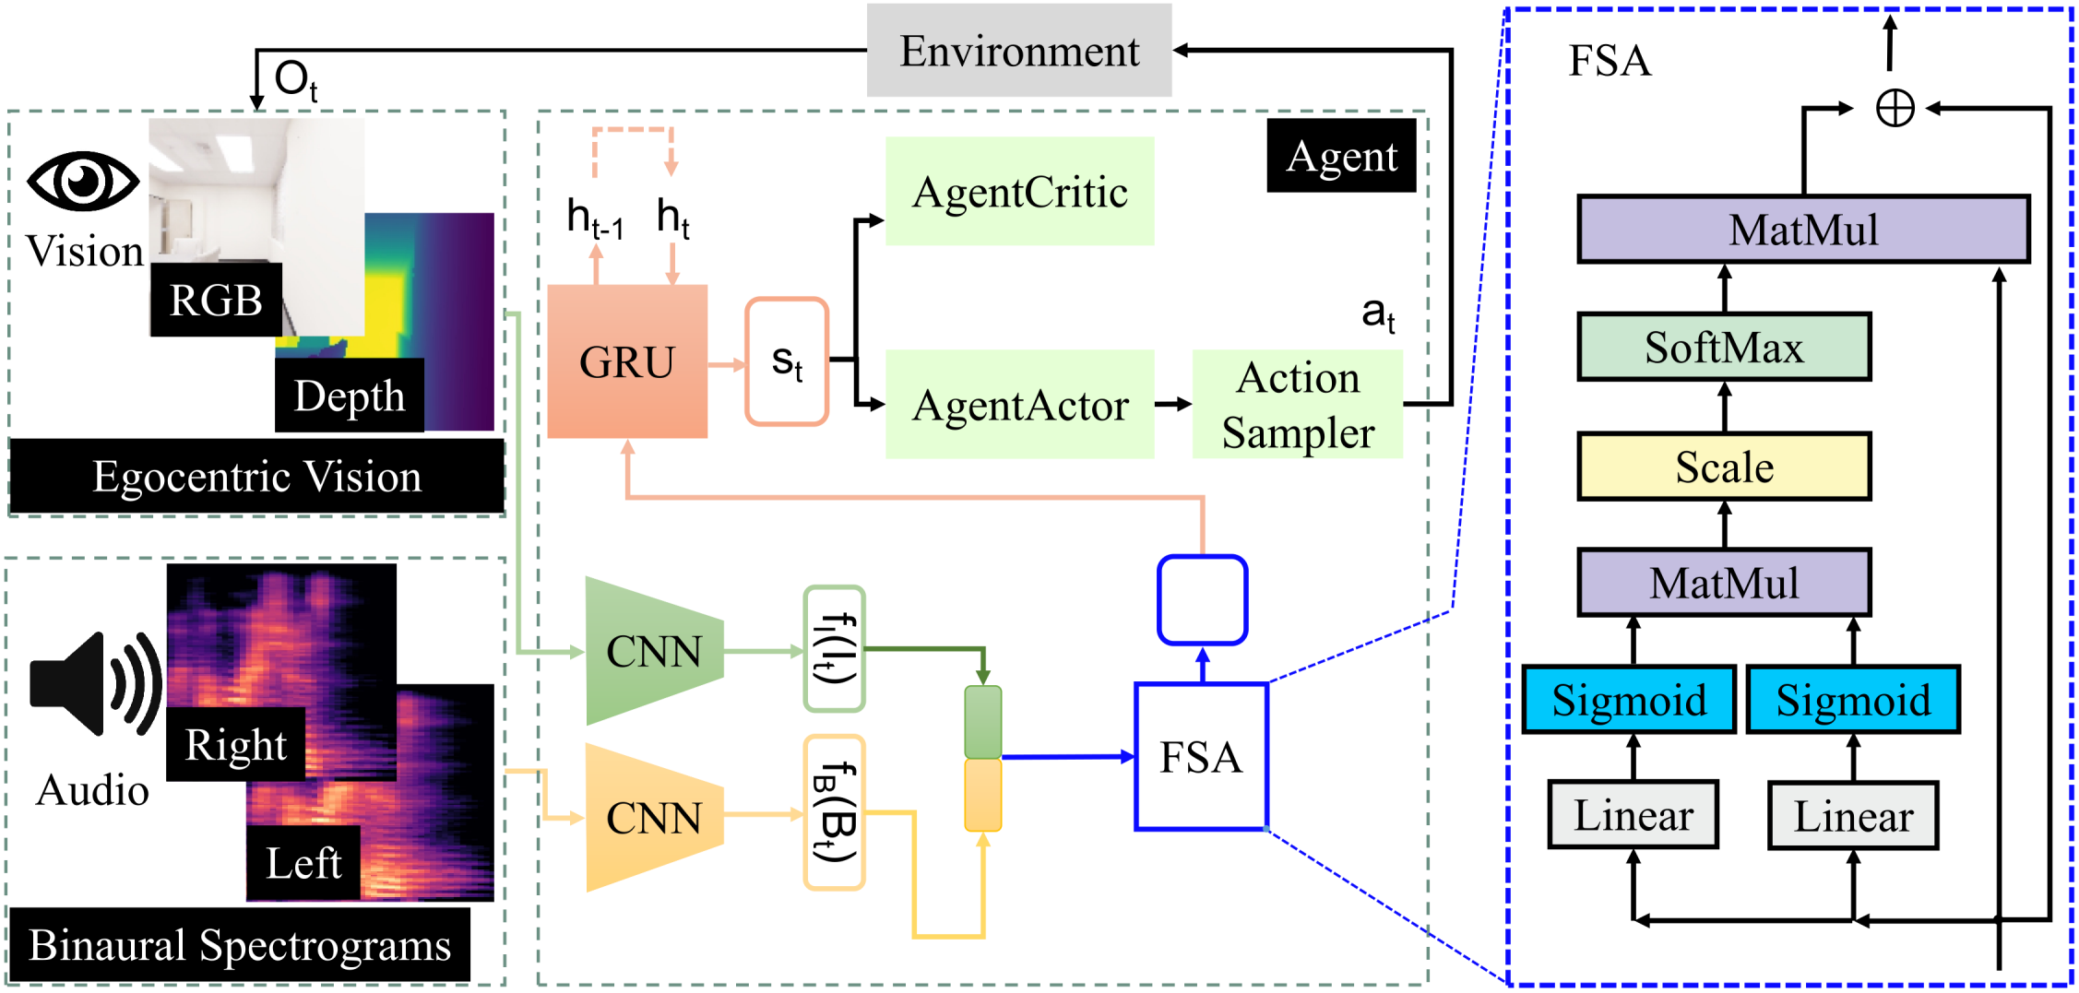

Pay Self-Attention to Audio-Visual Navigation
Yinfeng Yu, Lele Cao, Fuchun Sun, Xiaohong Liu, Liejun Wang
Tsinghua University (THU)
Motivation
Results
The relative contribution of each modal in real-time is dynamically different[1] at a separate time step. So how to learn the fusion dynamically? We summarize the current fusion method for audio-visual fusion in audio-visual navigation and propose our solution in the following figure.
Table 1: Overall performance comparison (STDEV≤0.01) using depth and sound input.
Table 1: shows that FSAAVN using FSA fusion, constantly performs the best (in boldface) on both datasets in all splitting settings.
High-level illustration of different feature fusion methods in audio-visual navigation.
Contributions
Table 2: Performance Comparison (STDEV≤0.01) of different vision modalities.
Navigation trajectories by the end of a particular episode from (a) Replica and (b) Matterport3D dataset.
Higher SPLT values and shorter blue paths indicate better performances.
We propose an end-to-end framework (FSAAVN) to address a currently under-researched problem: audio-visual navigation to chase a moving sound target.
We design a novel audio-visual fusion module (FSA) for learning a context-aware strategy to determine the relative contribution of each modal in real time.
We experimentally benchmark our approach towards the state-of-the-art in 3D environments, showing the superior performance of FSAAVN.
The thorough comparison of different variants of the fusion module (above Figure) and visual/audio encoder [The considered encoders: CNN (convolution neural network), ViT (vision transformer), Capsule. ] provides valuable insights for future practitioners in this field.
From Table 2, we can conclude that:
1) among all tested modalities, depth alone achieves the best performance;
2) with the same modality, FSA performs better than simple concatenation;
3) in the case of the blind, FSA seems slightly worse than concatenation, probably caused by FSA’s higher flexibility and complexity than concatenation.
Task
Visualization of visual feature, audio feature, and state representations from Replica dataset.
Table 3: Performance Comparison (STDEV≤0.01) of different visual/audio encoder backbones.
Conclusion
Table 3 shows the results of using different encoders while keeping the other parts the same.
We can see that the overly complex encoders (Capsule and ViT-based ones) are inferior to the CNN encoder.
We assume that higher complexity increases the convergence difficulty and thus makes policy learning more challenging.
To realize a more effective (than the existing methods) audio-visual feature fusion strategy during audio-visual embodied navigation, we design a trainable Feature Self-Attention (FSA) module that determines the relative contribution of visual/audio modal in real-time following the ever-changing context.
We propose an end-to-end framework (FSAAVN: feature self-attention audio-visual navigation) incorporating FSA to train robots to catch up with a moving audio target.
FSAAVN is easy to train since it requires no extra aid like topology graphs and sound semantics.
Our comprehensive experiments validate the superior performance (both quantitatively and qualitatively) of FSAAVN compared to the state-of-the-art.
We also conduct thorough ablation studies on mainstream visual modalities, signal (visual/audio) encoders and audio-visual fusion strategies, providing valuable insights for practitioners and researchers in this field.
Audio-visual embodied navigation with a moving sound source as the target: a blue robot chases a moving target (red), a low-speed robot emitting sound.
Neural network model
The left figure shows the impact scores (for two episodes in two rows) on the egocentric robot view at different time steps.
We can see that FSAAVN dynamically re-weight the modalities (according to the current surroundings)
while chasing after the moving audio target.
Reference
[1] C. Chen*, U. Jain*, et al., SoundSpaces: Audio-Visual Navigation in 3D Environments, ECCV 2020
Project & Code
https://yyf17.github.io/FSAAVN
The overview of FSAAVN: Feature Self-Attention Audio-Visual embodied Navigation.
Dynamic visual and echo impact for two episodes. Columns corresponds to three sampled time steps. The green and orange bars represent the importance of audio and vision, respectively.
Notes:
It

